Slide 1
Cost-Effective Equity Building in Ames, IA

Slide 2
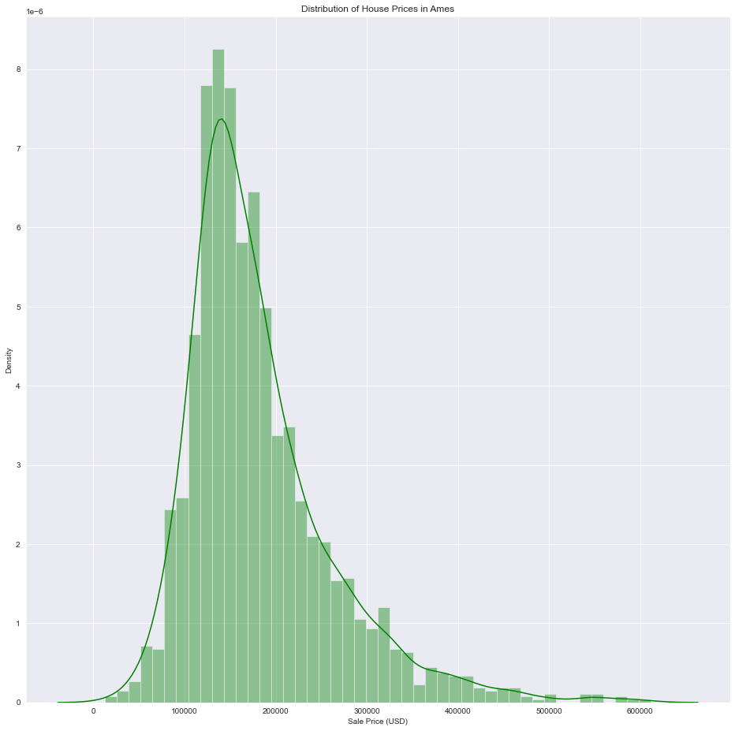
Average House Price: $181,529
Mean Sqft: 1,950

Slide 3
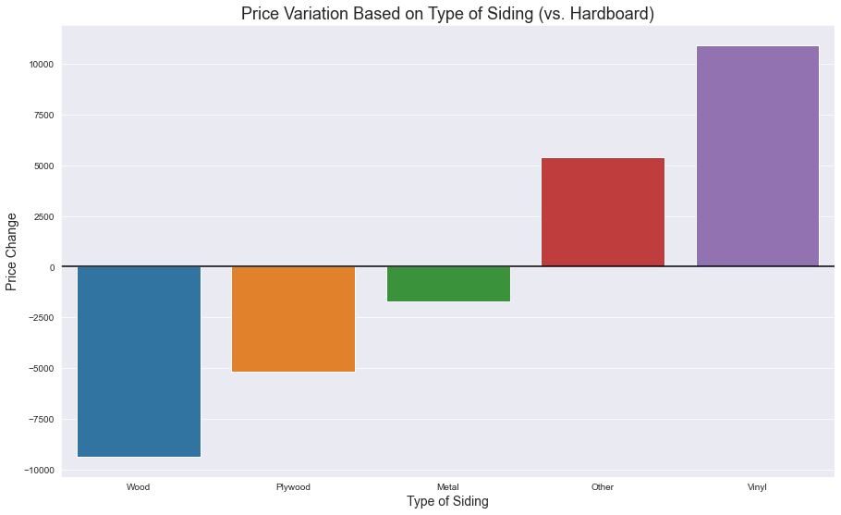
Vinyl siding average cost:
$5.00 / sqft
$7,950
https://homeguide.com/costs/vinyl-siding-cost
https://www.3ghomeimprovements.com/2019/03/12/what-is-hardboard-siding-and-why-does-it-fail/

Slide 4
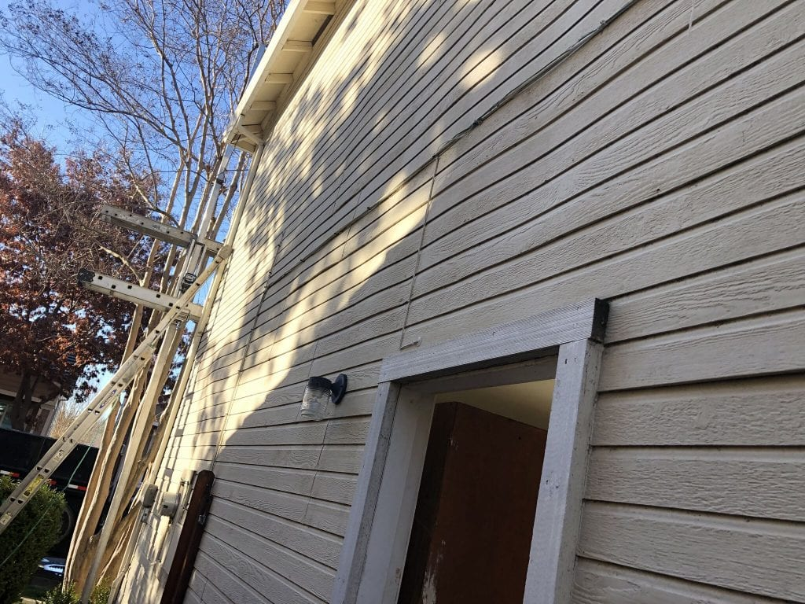

Slide 5
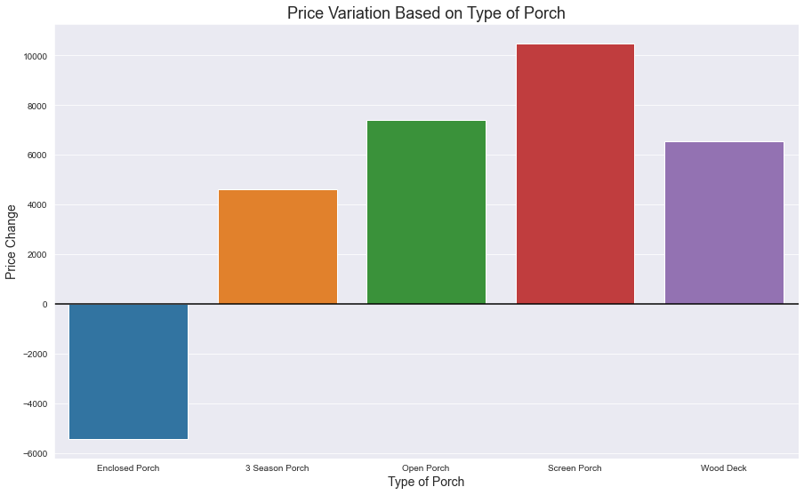
Average Porch Cost:
$10,500
Average Screening Cost:
$2,400
Average Wood Deck:
$5,620
https://www.homeadvisor.com/cost/outdoor-living/screened-in-porch/
https://www.homeadvisor.com/cost/outdoor-living/build-a-porch/
https://www.improvenet.com/r/costs-and-prices/wood-deck-estimator

Slide 6
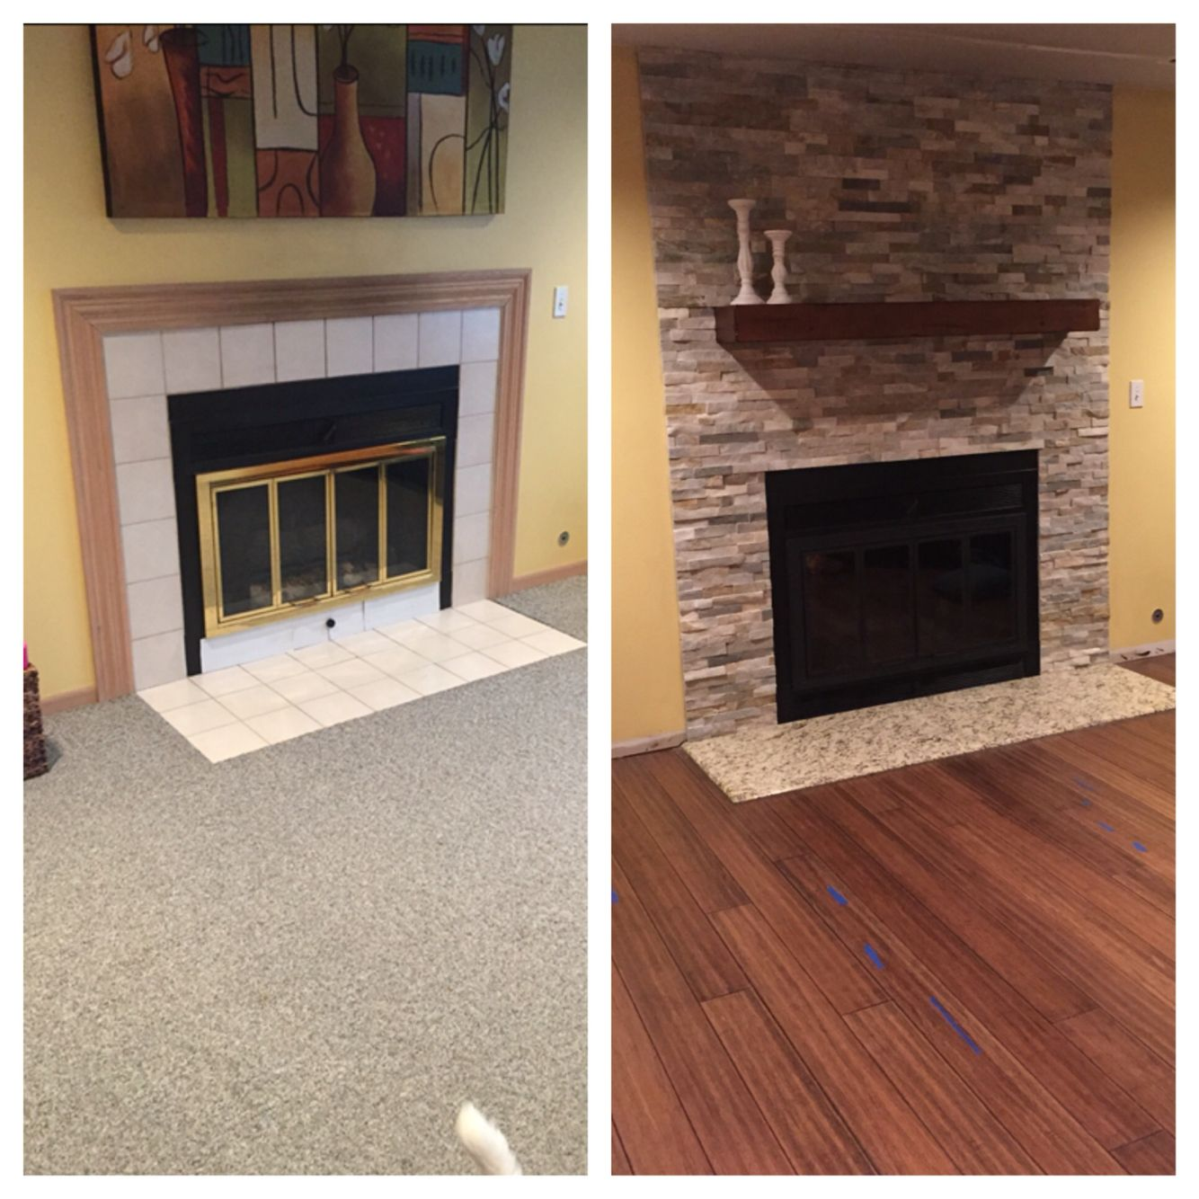
Average Forced Air Furnace:
$2,700 (cost)
$12,637 (return)
Average Kitchen Remodel:
$16,600
$3,452 per unit
Average Driveway Paving:
$2,000
$3,066
Average Fireplace Remodel:
$1,200
$987 per unit
$3,750 new
https://www.homewyse.com/services/cost_to_install_forced_air_furnace.html
https://homeguide.com/costs/kitchen-remodel-cost
https://www.remodelingexpense.com/costs/cost-to-pave-a-driveway/
https://www.improvenet.com/r/costs-and-prices/fireplace-remodeling-cost
https://homeguide.com/costs/fireplace-installation-cost
https://www.pinterest.com/pin/212513676144886553/

Slide 7
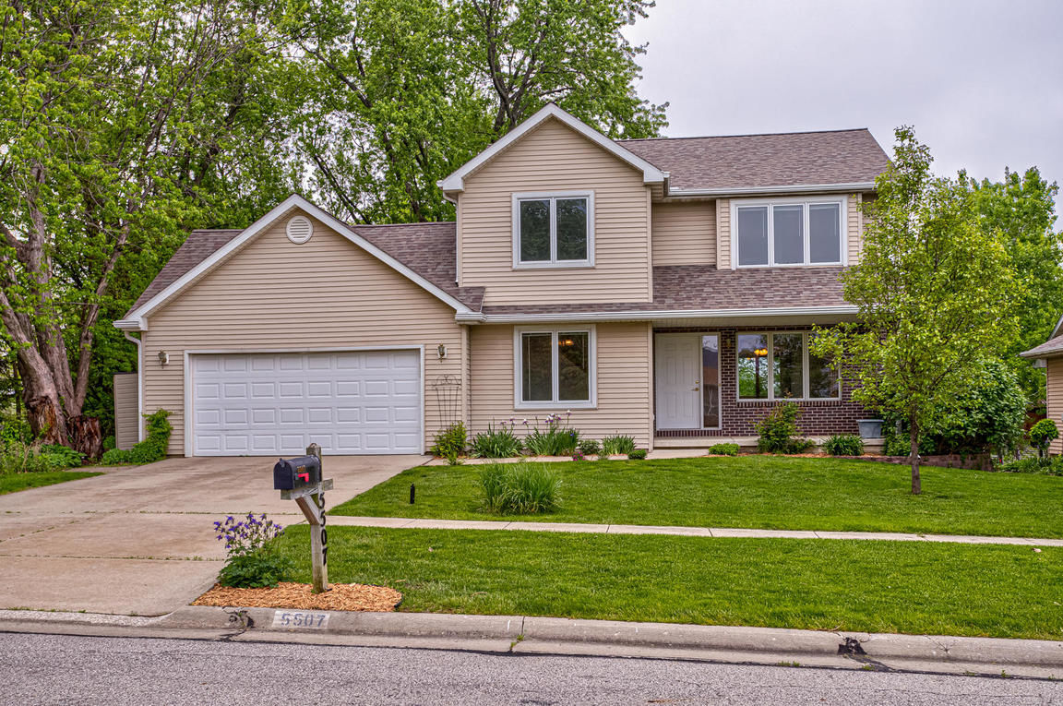
Conclusions
Vinyl Siding
Porches
Forced Air
Kitchen
Driveway
Fireplace
https://www.homes.com/ames-ia/houses-for-sale/p2/

